Slide 1
Project Presentation of Industry Oriented Hands on Experience (22CS422)
On
Hybrid ML-Based Multilingual SMS Scam Detection
TEAM MEMBERS :
Monalika Payal Prachi Malik
2210990582 2210990647 2210990661
Supervised By:
Ms.Monika Aggrawal
Department of Computer Science and Engineering,
Chitkara University, Punjab

Slide 2
Introduction
The rapid growth of mobile communication in India has led to a significant rise in SMS-based frauds, commonly known as smishing attacks.
These scams often exploit linguistic diversity, especially through the use of Hinglish (a combination of Hindi and English), to bypass traditional detection systems.
Most existing spam detection models are designed for a single language and fail to handle the informal and code-mixed nature of such messages. Additionally, many systems are limited to binary classification (spam vs. ham), which does not provide detailed insights into the type of fraud. To address these challenges, this research proposes a hybrid machine learning and deep learning model that effectively detects and classifies multilingual SMS scams into 12 categories.

Slide 3

Problem Statement
Despite the advancement in spam detection techniques, existing systems face major limitations when dealing with multilingual and code-mixed text such as Hinglish.
Attackers exploit this gap by using informal spellings and mixed-language content to evade detection. Moreover, traditional models primarily focus on binary classification, which is insufficient for identifying the exact nature of scams.
This lack of granularity reduces the effectiveness of security systems in providing appropriate responses. Therefore, there is a need for a robust system that can accurately detect and classify different types of SMS scams in a multilingual environment.

Slide 4

Objectives
The primary objective of this research is to develop an efficient SMS scam detection system for Hinglish text using a hybrid approach.
The model aims to combine statistical feature extraction techniques like TF-IDF with deep learning models such as LSTM to improve detection accuracy.
Another key goal is to move beyond binary classification and categorize messages into 12 distinct fraud classes, such as OTP fraud, banking scams, and lottery scams. The system is also designed to enhance real-time detection capabilities and provide more actionable insights for users.

Slide 5
Methodology
The proposed system follows a hybrid late fusion architecture that combines both machine learning and deep learning techniques. The process begins with data preprocessing, including cleaning, handling missing values, and encoding labels. The model then uses two parallel streams: a TF-IDF-based statistical feature extraction stream and an LSTM-based contextual learning stream. These two streams are combined using a fusion layer, and the final output is passed through a softmax classifier to predict one of the 12 scam categories.
The TF-IDF (Term Frequency-Inverse Document Frequency) technique is used to extract important keywords from the SMS messages. It assigns higher weights to words that appear frequently in a specific message but are rare across the dataset. This helps in identifying common scam-related terms such as “lottery”, “KYC”, and “paise”. The TF-IDF approach provides statistical importance to words and ensures that critical keywords are effectively captured, regardless of their position in the message.

Slide 6
The LSTM (Long Short-Term Memory) network is used to capture the contextual and sequential nature of the text data. Since Hinglish messages often have irregular grammar and mixed language patterns, LSTM helps in understanding the overall intent of the message rather than relying only on keywords. The text is first tokenized and converted into numerical form using embedding layers. The LSTM model then processes the sequence to identify patterns and relationships between words, enabling the detection of complex scam messages.
The hybrid model combines the strengths of both TF-IDF and LSTM using a late fusion technique. While TF-IDF captures the statistical importance of keywords, LSTM captures the contextual meaning of the message. The outputs of both models are concatenated into a single feature vector, which is then passed to a classification layer. This combined approach improves the accuracy and robustness of the system, as it does not rely solely on either keywords or context.

Slide 7
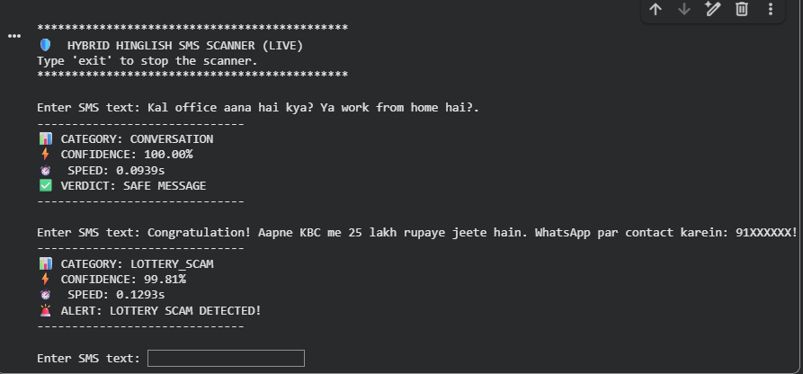
Results
The proposed hybrid model achieved an overall accuracy of 92.47%, outperforming traditional machine learning and deep learning models. It also demonstrated high precision, recall, and F1-score, indicating balanced performance across different classes.
The model showed excellent performance in detecting high-risk scam categories such as banking fraud and OTP scams. Additionally, it was able to handle class imbalance effectively and maintain high accuracy even in categories with fewer samples.It has real time sms detector in which we type a msg and it specifies which type of scam is this.

Slide 8

Conclusion
In conclusion, this research presents an effective solution for detecting multilingual SMS scams, particularly in Hinglish.
By combining TF-IDF and LSTM in a hybrid architecture, the model successfully captures both keyword-based and contextual information. The transition from binary classification to a 12-class system provides more detailed and actionable insights.
With an accuracy of 92.47%, the proposed model proves to be a reliable approach for enhancing mobile security and can be further extended for real-time applications.

Slide 9
Thank You

